Slide 1
Physical Media
Guided Media
Twisted Pair cable
Un-guided Media
Wireless Transmitters
WLAN
Fiber Optic Cable
Co-axial Cable
Satellite Channel

Slide 2
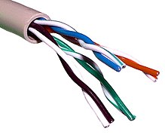
Twisted Pair Cable
Twisted pair cabling is a type of wiring in which two conductors of a single circuit are twisted together for the purposes of improving electromagnetic compatibility.
Less expensive and most commonly used
Mainly used in telephone line, home and work environment
Data rates upto 10 Mbps to 1 Gbps
Two types of cables:
UTP: Unshielded Twisted Pair
STP: Shielded Twisted Pair

Slide 3
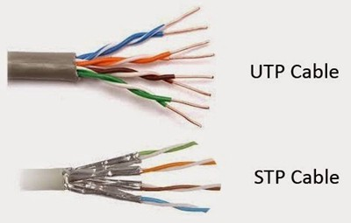
UTP
Less Expensive
Easy to install
STP
More Expensive as compare to UTP
Comparatively difficult to install
Mainly reduce noise
Mainly reduce electrical interference
Data rate is less
Data rate is high

Slide 4
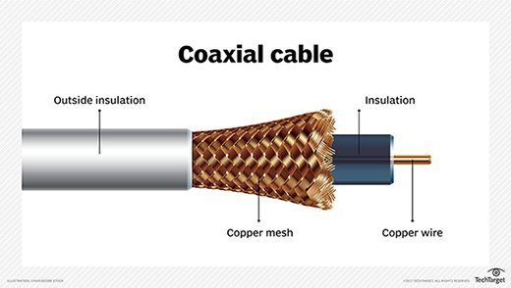
Co-axial Cable
Coaxial cable is a type of copper cable specially built with a metal shield and other components engineered to block signal interference.
It is primarily used by cable TV companies to connect their satellite antenna facilities to customer homes and businesses.
Higher bit rate1 Mbps for internet or higher

Slide 5
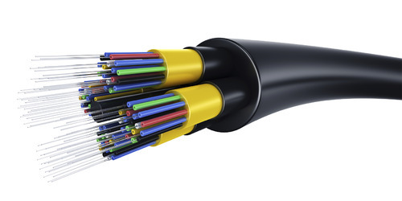
Fiber Optics
It is a thin and flexible medium
Speed is higher then other medium
It is used to reduce electromagnetic interference
It is used for long distance
Used in large networks, cost is high because of transmitters, switches and receivers

Slide 6
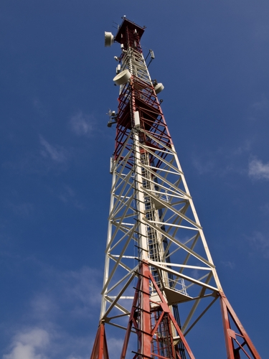
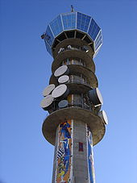
Terrestrial Radio Channel
No physical wire required
It will carry electromagnetic signals
Used for long distance and mobile users
Depends upon propagation
Pass loss and fading can decrease the signal strength

Slide 7
Satellite Radio Channels
A communication satellite links two or more microwave transmitters / receivers known as ground stations.
It receives the signals, regenerates it and transmits signal on another frequency to ground system.
Types of satellites:
Geostationary satellite: 36,000 km far from earth surface
Low earth orbiting (LEO) satellite: Very closer to the earth and rotate around earth

